Slide 1
Jenkins Advanced Integration with Testing Tools
Priya, Padmapriya, Agila & Mamta
June 2020

Slide 2
Agenda
Jenkins integration with Testing tools
JUnit
NUnit
SonarQube
TestNG & Selenium

Slide 3
Jenkins Integration with Testing tools

Slide 4
Jenkins Integration with JUnit

Slide 5

JUNIT Overview
JUnit is a unit testing framework for the Java programming language. JUnit has been important in the development of test-driven development, and is one of a family of unit testing frameworks
JUnit is an open source framework, which is used for writing and running tests.
JUnit tests allow you to write codes faster, which increases quality.
JUnit is elegantly simple. It is less complex and takes less time.
JUnit tests can be organized into test suites containing test cases and even other test suites.
JUnit shows test progress in a bar that is green if the test is running smoothly, and it turns red when a test fails.

Slide 6
Junit Overview
Below is the sample Test.Java file for a simple HealthCode Application. @Test, tells the JUnit that the public void method in which it is used can run as a test case
@Test
public void testSum()
{
int result = calculator.sum(3, 4);
assertEquals(7, result); }
@Ignore
@Test
public void testEqual()
{
boolean result = calculator.equalIntegers(20, 20); assertFalse(result);
}
@Test
public void testSubstraction()
{
int result = 10 - 3;
assertTrue(result == 7);
}

Slide 7

Jenkins – Junit Integration Freestyle Project (Using Maven)
Steps to do Junit Integration in a Freestyle Project
Open Jenkins Dashboard.
Click on New Item.
Enter an item name
Select a template – Freestyle project
Click on ok
Go to the source code Management section and select Git.
Provide the Repository URL.
In the Build Section, provide the POM.xml file.

Slide 8
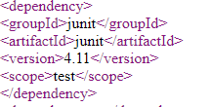
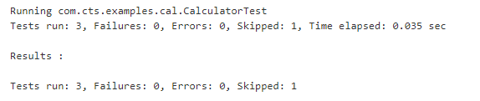
Jenkins – Junit Integration Freestyle Project (contd.)
POM.xml file contains the dependency for the Junit and the Unit test is triggered
By including the above dependency in POM.XML file, we can get the below console output

Slide 9
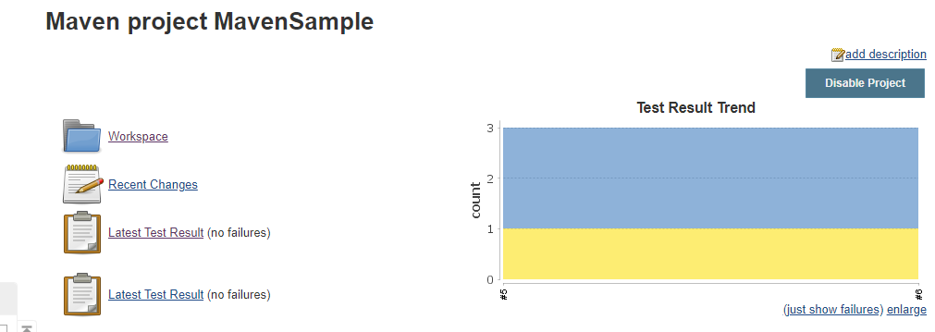
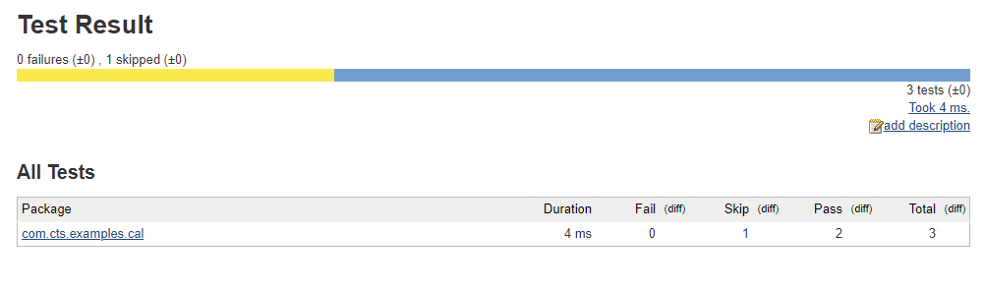
Jenkins – Junit Integration Freestyle Project (contd.)
Summary of the Test results also can be seen as below

Slide 10
Jenkins – Junit Integration Pipeline Project
Steps to do Jenkins integration in a Pipeline Project
Click New Item on your Jenkins home page, enter a name for your (pipeline) job, select Pipeline, and click OK.
In the Script text area of the configuration screen, enter your pipeline syntax. If you are new to pipeline creation, you might want to start by opening Snippet Generator and selecting the “Hello Word” snippet.
Pipelines are written as Groovy scripts that tell Jenkins what to do when they are run. You do not need deep expertise in Groovy to create them, although basic understanding of Groovy is helpful.

Slide 11
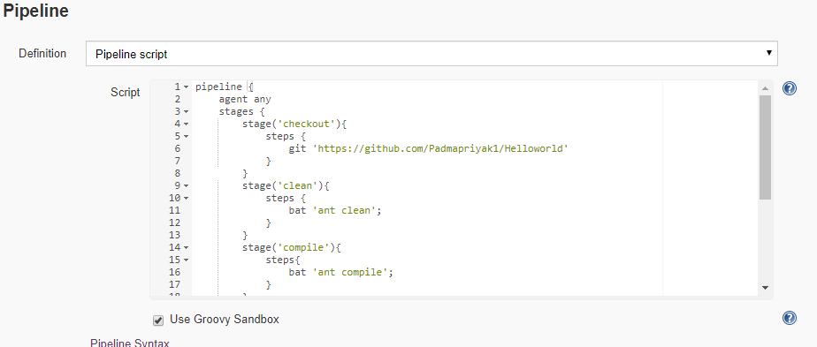
Jenkins – Junit Integration Pipeline Project (contd.)
Pipelines are written as Groovy scripts that tell Jenkins what to do when they are run. You do not need deep expertise in Groovy to create them, although basic understanding of Groovy is helpful.
Batch scripts in the steps is based on the targets in the build.xml file. In the build file, Junit_run target is defined to invoke the Unit tests. Attached is the sample build.xml file.

Slide 12
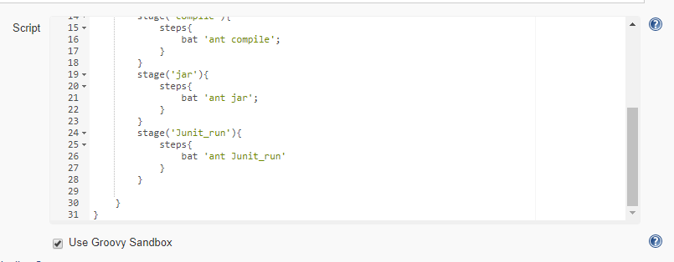
Jenkins – Junit Integration Pipeline Project (contd.)
Check the Use Groovy Sandbox option below the Script text area.
Click Save.
Click Build Now to create the pipeline, select Console Output to see the output.

Slide 13
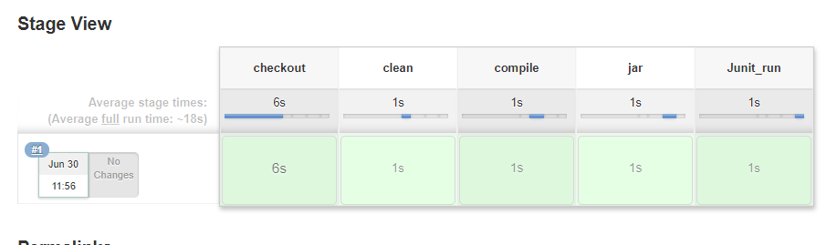
Jenkins – Junit Integration Pipeline Project (contd.)
Click Build Now to create the pipeline, select Console Output to see the output. Also can see the project pipeline in the project page.

Slide 14
Jenkins Integration with NUnit

Slide 15

NUnit Overview
NUnit is a unit-testing framework for all .Net languages. NUnit is Open Source software and NUnit 3.0 is released under the MIT license. This framework is very easy to work with and has user friendly attributes for working.
Enables writing test cases while developing the software that helps test early and detect issues.
Ensure the functionality is performing as expected every time the code is modified by the use of repeatable automated test cases.
For integration with Jenkins, Nunit Console has to be installed in the Jenkins server. In order to compile .Net application, .Net framework(MSBuild.exe) must be present in the Jenkins server.

Slide 16
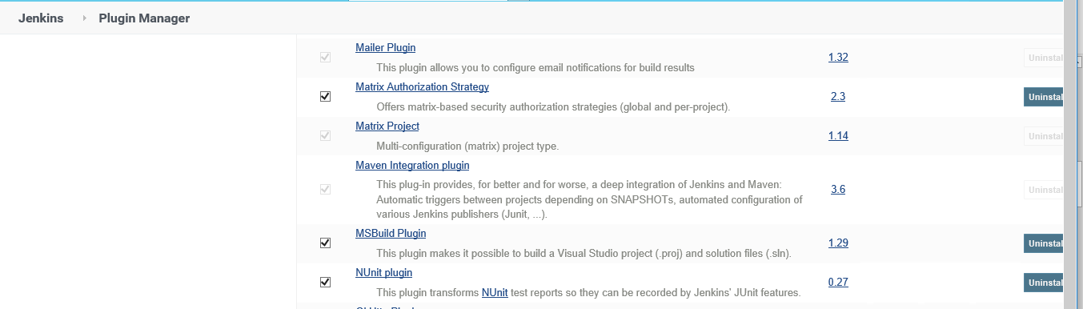
NUnit Plugin Installation in Jenkins
Login to your Jenkins instance and go to Manage Jenkins
Click on Manage Plugins and go to Advanced tab
Go to the Upload Plugin section
Browse the path where nunit.hpi file you have downloaded and click Upload button
NUnit plugin is installed in Jenkins and it can be viewed in Installed tab of Manage Jenkins page. Additionally, MSBuild plugin can be installed to build .Net projects.

Slide 17
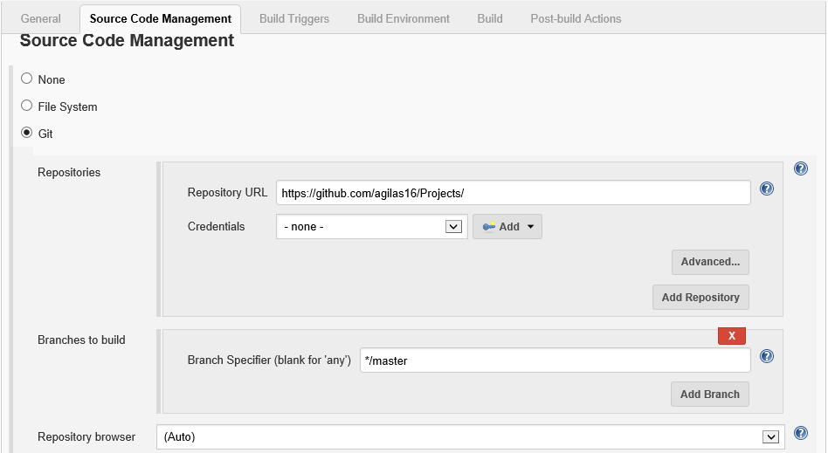
NUnit FreeStyle Project
1. Create NUnit FreeStyle Project by providing its Name and Description
2. Provide the source code path in the Source Code Management Section
3. In the Build section, choose Build a visual studio project or solution using MSBuild option and select MSBuild version as MS Build .Net 4.0(as set in Global configuration).

Slide 18
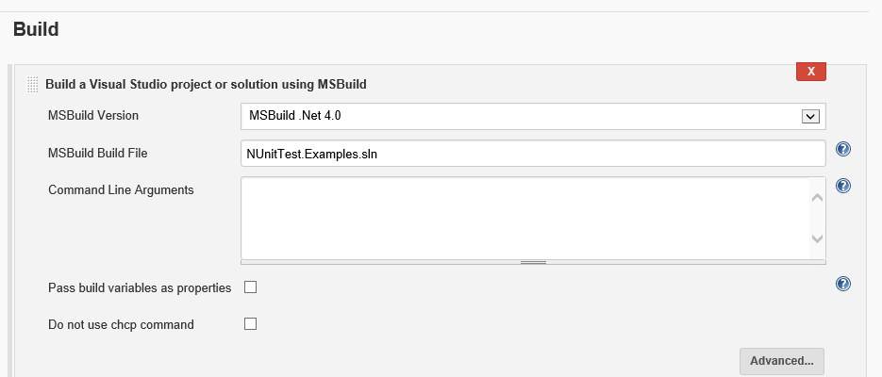
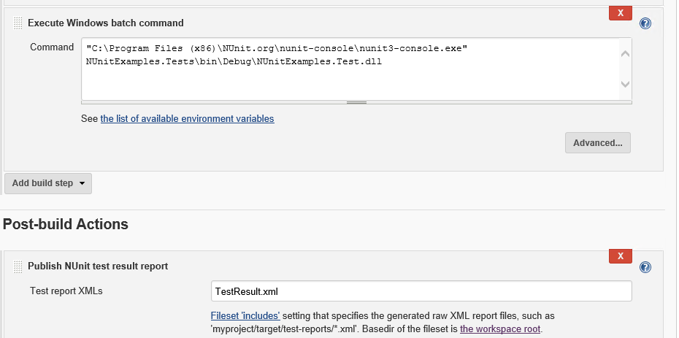
NUnit FreeStyle Project
4. Provide Tasks as ‘clean build’ which will clean the existing build of the application and then build & run the application.
5. Mention the path of the build file and save the project.
6. When you click the build now option, source code will be extracted from GIT, compiled using MSBuild, test cases will run using Nunit and test results are finally generated. If any of the test case fails, entire build will be marked as failed.

Slide 19
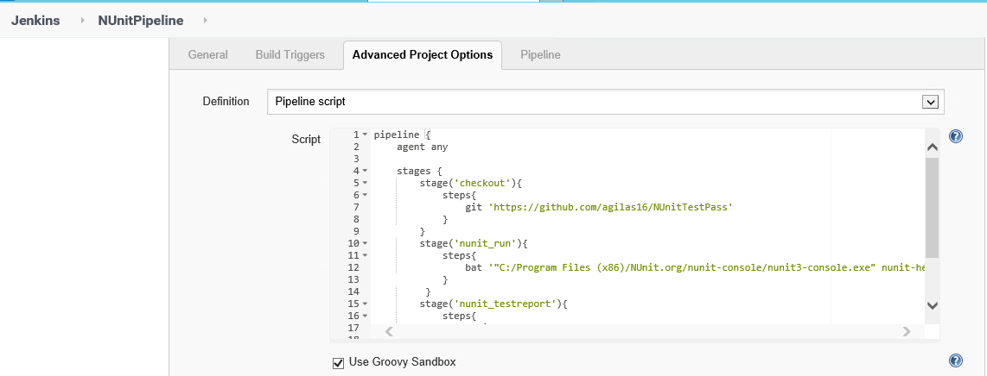
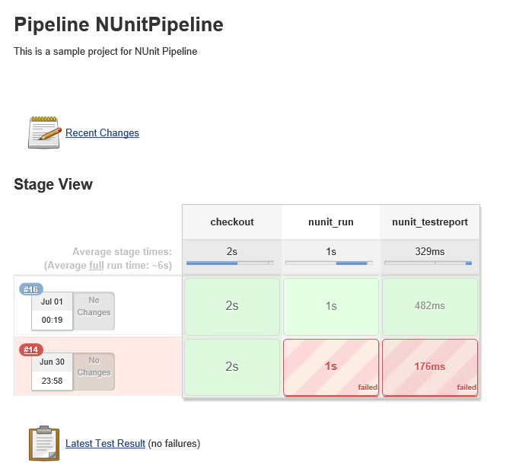
NUnit Pipeline Project
1. Create NUnit Pipeline Project by providing its Name and Description
2. Create Pipeline script in Pipeline Section
3. Save the project
4. Click on Build Now option, pipeline project will get executed and test result will be created.

Slide 20
Jenkins Integration with SonarQube

Slide 21
SonarQube Overview
SonarQube is an Open Web based Application Platform to manage Code Quality. It offers central place to manage Code Quality and Visual Reporting across Projects.
SonarQube is an automatic code review tool to detect bugs, vulnerabilities and code smells in your code. It can integrate with your existing workflow to enable continuous code inspection across your project.
SonarQube is a Static Analysis tool which analyses the code to detect the following for around 15 Programming Languages
Bugs
Code Smells
Vulnerabilities
SonarQube uses H2 database internally to store information on Projects, Quality & other details.

Slide 22
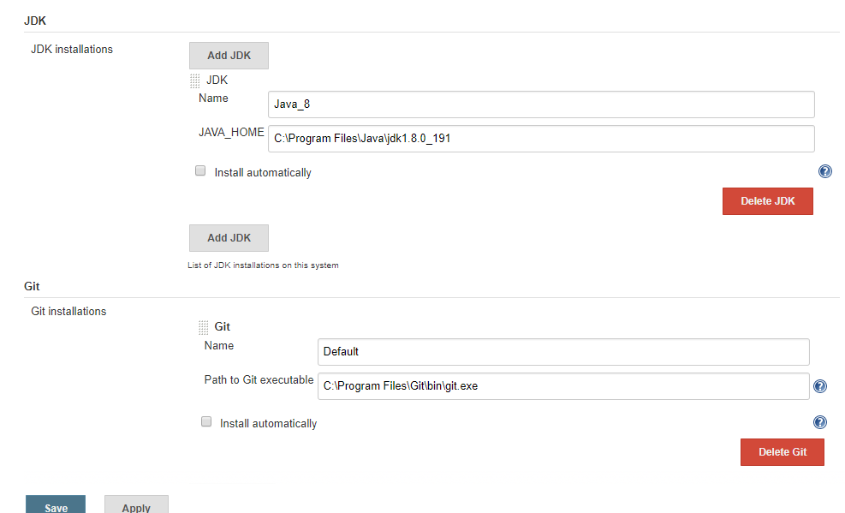
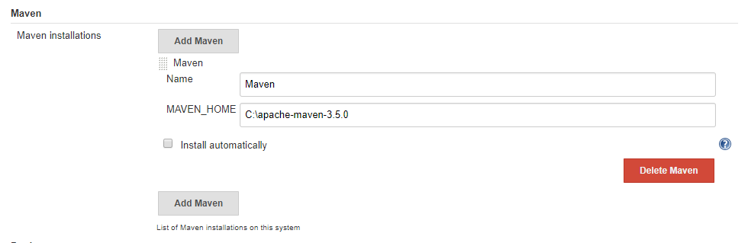
Configure Java, GitHub & Maven
Manage Jenkins > Global Tool Configuration

Slide 23
Install Plugins
Manage Jenkins > Manage Plugins
Download hpi files of below plugins –
Maven Integration
GitHub Plugin
SonarQube Scanner for Jenkins
b. Manage Plugins > Advanced > Upload Plugin > Choose hpi files & Upload

Slide 24
Install Plugins
Manage Jenkins > Manage Plugins
Download hpi files of below plugins –
Maven Integration
GitHub Plugin
SonarQube Scanner for Jenkins
b. Manage Plugins > Advanced > Upload Plugin > Choose hpi files & Upload

Slide 25
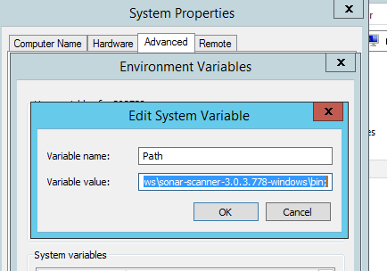
Setup SonarQube & Sonar Scanner
1. After installation of SonarQube & Sonar Scanner , start SonarQube using StartSonar.bat
Port can be changed using sonar.properties file
2. Test Sonar Link : http://localhost:9000
3. Append System
Environment Variable
Path with Sonar Scanner
path

Slide 26
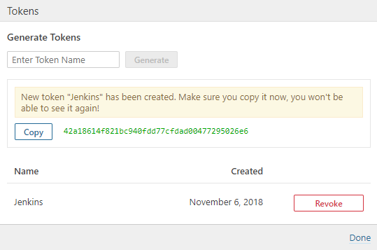
Security Token for SonarQube Authentication
1. Administration > Security > Users > Token > Generate Token > Copy the token

Slide 27
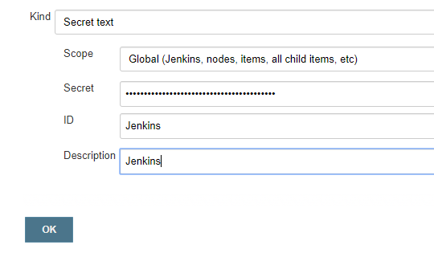
Secret Text in Jenkins
Jenkins Home > Credentials > System > Add credentials > Choose Secret Text >
Enter(paste) the token in Secret textbox > ID should be the token name provided to token in SonarQube

Slide 28
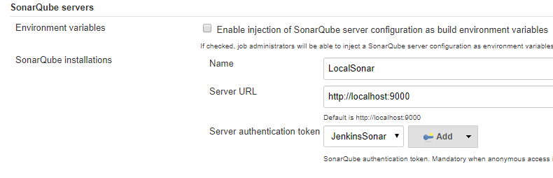
Configure SonarQube in Jenkins
Manage Jenkins > Configure System > SonarQube server section > Add SonarQube > Provide a name & URL of SonarQube > Choose credentials in Server authentication token textbox.

Slide 29
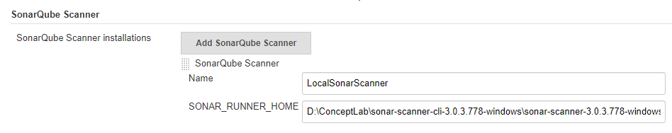
Configure Sonar Scanner
Manage Jenkins > Global Tool Configuration > Scroll for SonarQube Scanner > Add sonar scanner > name it & provide path to sonar runner home

Slide 30
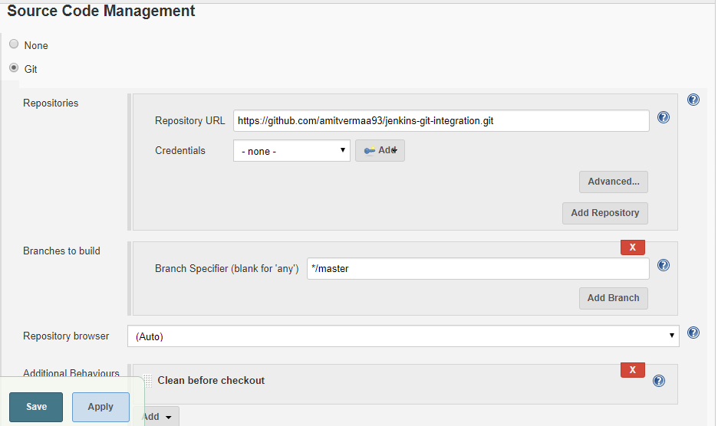
Create Jenkins Maven Project
1. Create a Job- New Item > Name and select project type – Maven
2. Provide SCM details - https://github.com/amitvermaa93/jenkins-git-integration.git

Slide 31
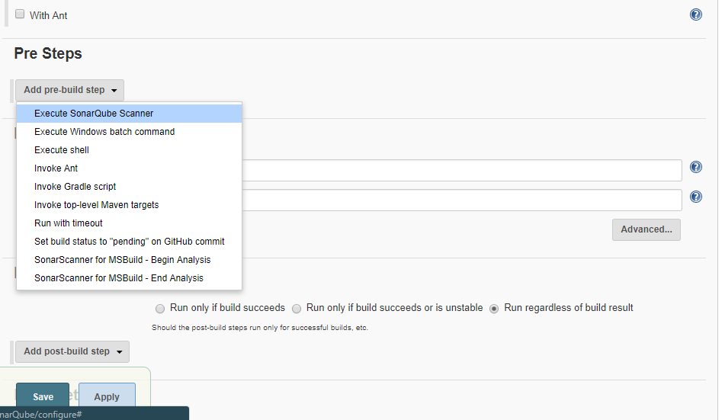
3. Set Git under SCM section and use * * * * * for Poll SCM under Build Trigger section.
4. Under Build Environment section add pre-buid step > select Execute SonarQube Scanner

Slide 32
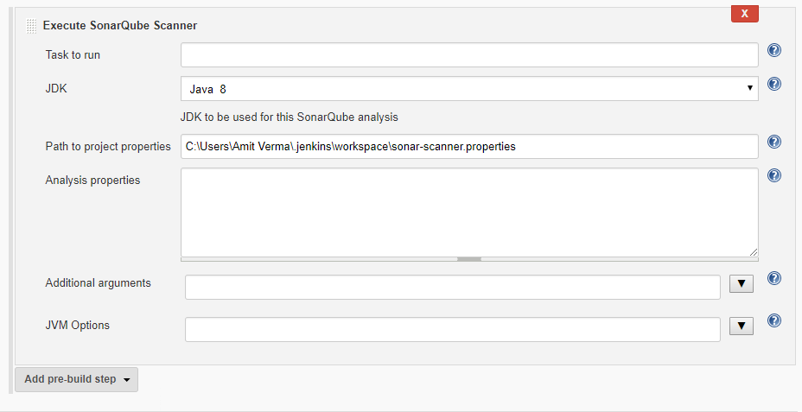
5. Create a .properties file at any location. This property file will be project specific. It contains certain sonar properties like which folder to scan, which folder to exclude in scanning, what is the project key.

Slide 33
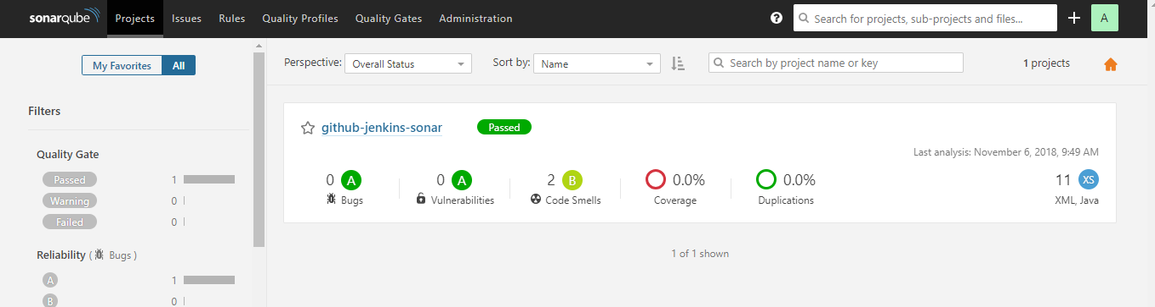
6. Inside sonar-scanner.properties write below code —
sonar.projectKey=github-jenkins-sonar-maven
sonar.sources=C:/Windows/System32/config/systemprofile/.jenkins/workspace/MavenSonar/src
7. Build the job. After successful build if you can see build logs it will show you the files and folder it has scanned and after scanning it has posted the analysis report to SonarQube Server you have integrated.
8. From job dashboard, click on sonar icon or navigate to Sonar server click on Projects (on header) you will see a new project with same project key you have given in sonar-scanner.properties file. Now you can go inside your project and analyse the report .

Slide 34
Sonar Pipeline
node {
stage('SCM') {
git 'https://github.com/foo/bar.git' }
stage('SonarQube analysis') {
def scannerHome = tool 'LocalSonarScanner';
withSonarQubeEnv('LocalSonar') { // If you have configured more than one global server connection, you can specify its name
bat "${scannerHome}/bin/sonar-scanner"
}
}
}

Slide 35
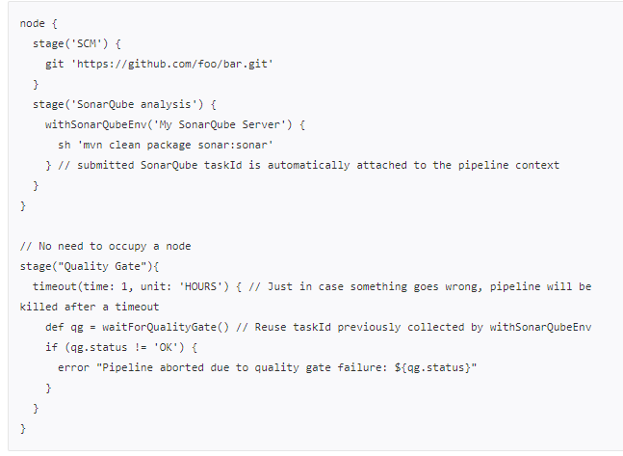
Pause pipeline until quality gate is computed

Slide 36
Jenkins Integration with TestNG & Selenium

Slide 37
Why Jenkins and Selenium?
Running Selenium tests in Jenkins allows you to run your tests every time your software changes and deploy the software to a new environment when the tests pass.
Jenkins can schedule your tests to run at specific time.
You can save the execution history and Test Reports.
Jenkins supports Maven for building and Testing a project in continuous integration.

Slide 38
Selenium WebDriver Script
public class demoProgram1 {
public static void main(String[] args) {
//Location of the chrome driver exe
System.setProperty("webdriver.chrome.driver","D:\\GR\\Work\\LearnSelenium\\Driver\\chromedriver.exe");
//Instantiating a driver object
WebDriver driver = new ChromeDriver();
//Navigating to URL
driver.get("http://sharelane.com");
WebElement link_obj = driver.findElement(By.linkText("ENTER"));
link_obj.click();
link_obj = driver.findElement(By.xpath
("/html/body/center/table/tbody/tr[3]/td/table/tbody/tr/td[1]/p/input"));
link_obj.sendKeys("sathish.gk@gmail.com");
}
}

Slide 39
Pom.xml
<dependency>
<groupId>org.seleniumhq.selenium</groupId>
<artifactId>selenium-java</artifactId>
<version>3.141.59</version>
</dependency>
<dependency>
<groupId>org.testng</groupId>
<artifactId>testng</artifactId>
<version>6.14.3</version>
<scope>test</scope>
</dependency>

Slide 40
Pom.xml
<plugin>
<groupId>org.apache.maven.plugins</groupId>
<artifactId>maven-surefire-plugin</artifactId>
<version>3.0.0-M3</version>
<configuration>
<suiteXmlFiles>
<suiteXmlFile>testng.xml</suiteXmlFile>
</suiteXmlFiles>
</configuration>
</plugin>

Slide 41
Thank You
Engineering Excellence Team

